Slide 1
Complex Inheritance of Common Multifactorial Disorders

Slide 2
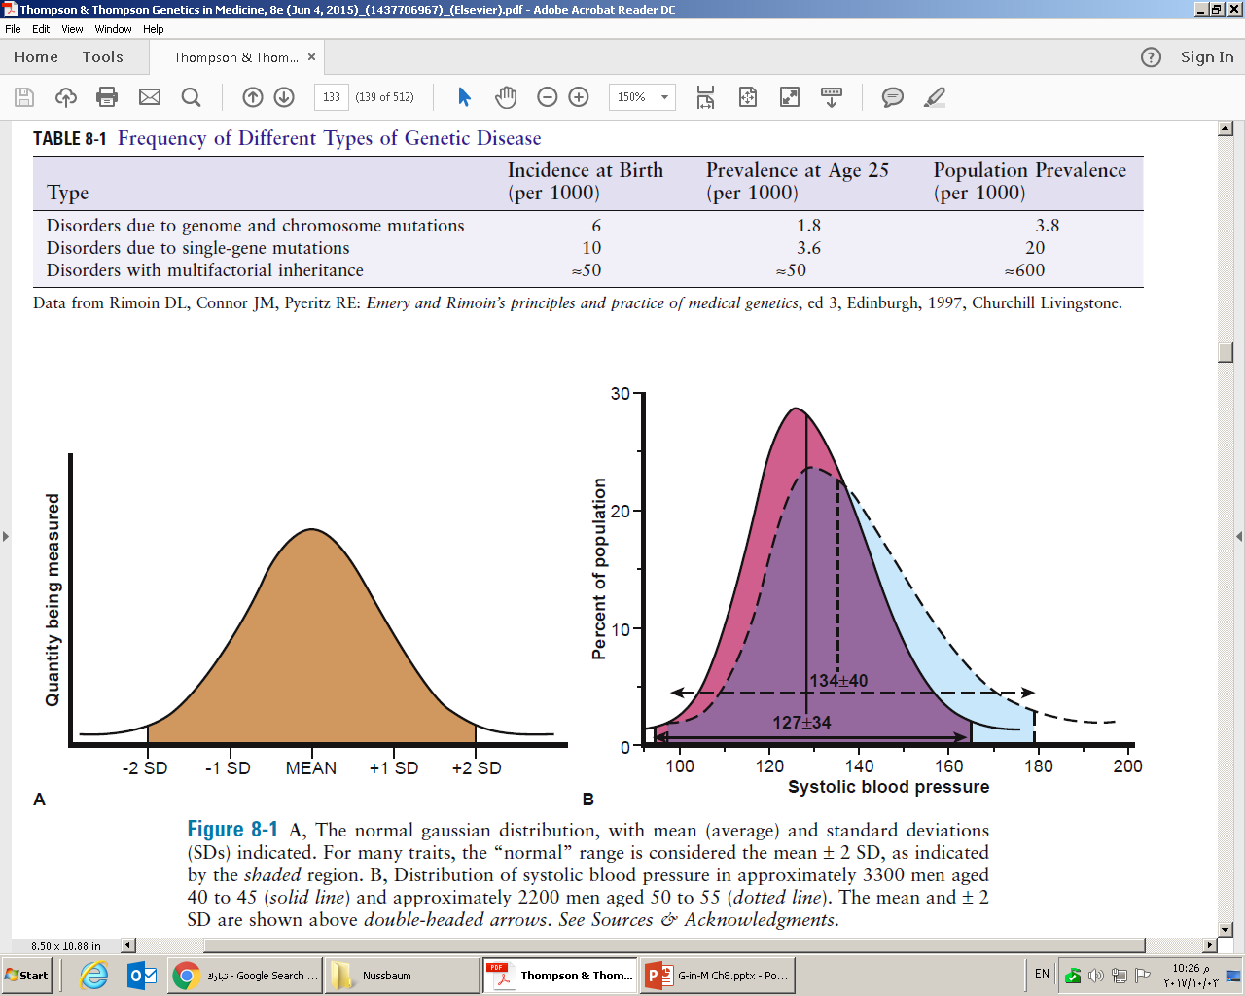
TABLE 9-1
Qualitative traits (binary)
Quantitative traits

Slide 3
Figure 9-1

Slide 4
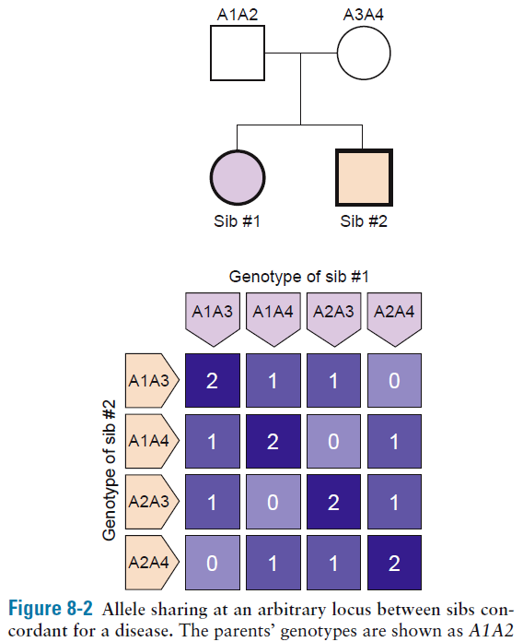
First-degree relatives, on average, share 50% of their alleles
At any one locus, the
average number of alleles an individual is expected to
share with a sibling is:
¼ (2 alleles)+ ¼(0 allele)+ ½(1 allele)
= 0.5+0+0.5
= 1 allele
By analyzing the genetic contribution from both parents, a Punnett square helps determine the potential alleles (variants of genes) each child might inherit, and the probability of inheriting specific traits or conditions based on those alleles.
Figure 9-2

Slide 5
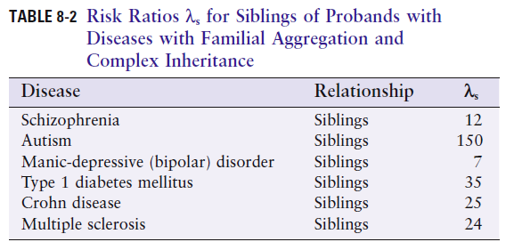
Relative risk ratio λ_{r} measures familial aggregation of disease:
λ_{r}= disease prevalence in relatives of affected/disease prevalence in population
TABLE 9-2
Family history case control studies
e.g. 3.5% of first degree relatives of patients with MS had MS compared to first-degree relatives of matched controls without MS (0.2%), 18 times higher, thus genetic predisposition

Slide 6
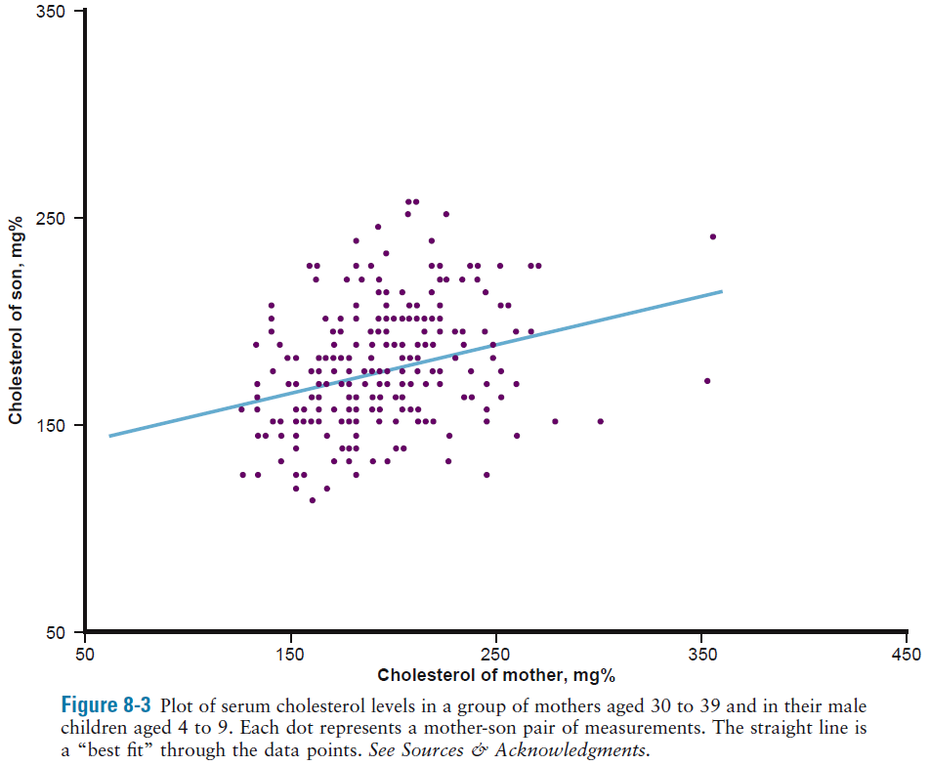
Coefficient of correlation
To see if a physiological parameter is more similar between relatives
Here r=0.29, positive correlation (r=0 - 1)
Heritability H² (0-1): fraction of the variation in a quantitative trait that is due to genetic variation
Figure 9-3

Slide 7
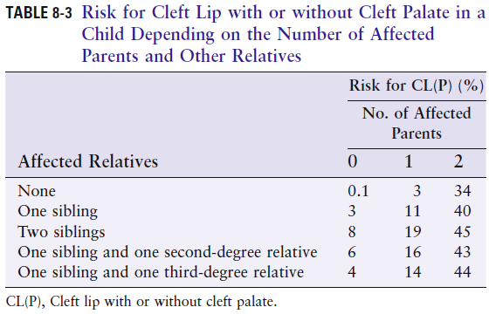
The risk for disease increases as a function of the number of relatives the child has who are affected and the more closely related they are to the child – clear genetic involvement
TABLE 9-3

Slide 8
Twinning
MZ and DZ twins are “experiments of nature” that provide an excellent opportunity to separate environmental and genetic influences on phenotypes in humans

Slide 9
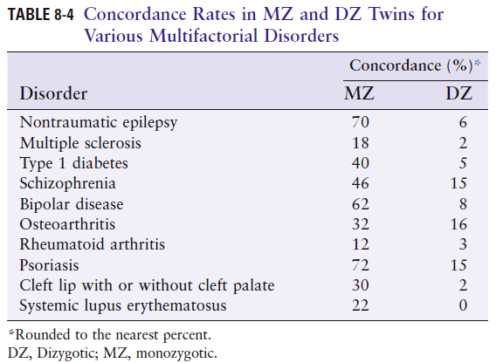
Concordance of MZ with sickle cell disease is 100%
Concordance of MZ with type 1 diabetes is 40%
Concordance less than 100% in MZ twins suggests nongenetic factors play a role in disease
Greater concordance in MZ versus DZ twins is a strong evidence of a genetic component of disease
TABLE 9-4

Slide 10
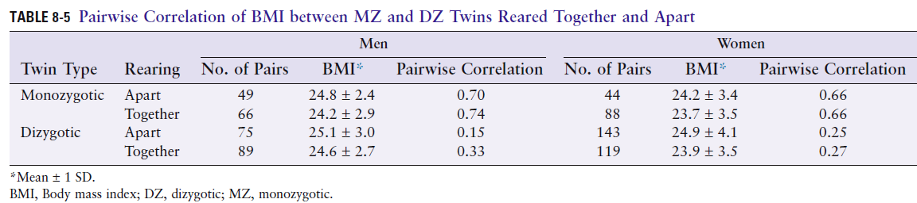
Twins reared apart to analyze contribution of environment
TABLE 9-5
Although average BMI among MZ or DZ twins was similar, regardless of whether they were reared together or apart
→ pairwise correlation for BMI between a pair of twins was much
higher for MZ than DZ twins
The higher correlation between MZ versus DZ twins was independent of whether the twins were reared together or apart
→genetics has a highly significant impact on adult weight

Slide 11
Genome-wide association studies (GWAS)
Particularly fruitful in identifying disease susceptibility loci and biologic pathways, elucidating the genetic architecture of many complex diseases
Concept: Examining each individual genetic variant for evidence of association with a disease phenotype or quantitative trait

Slide 12
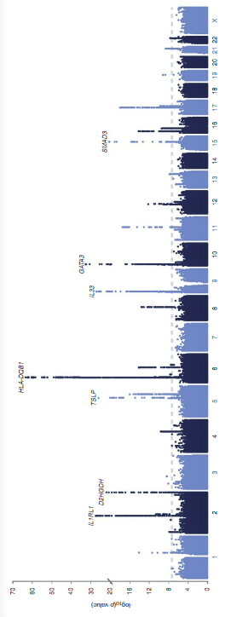
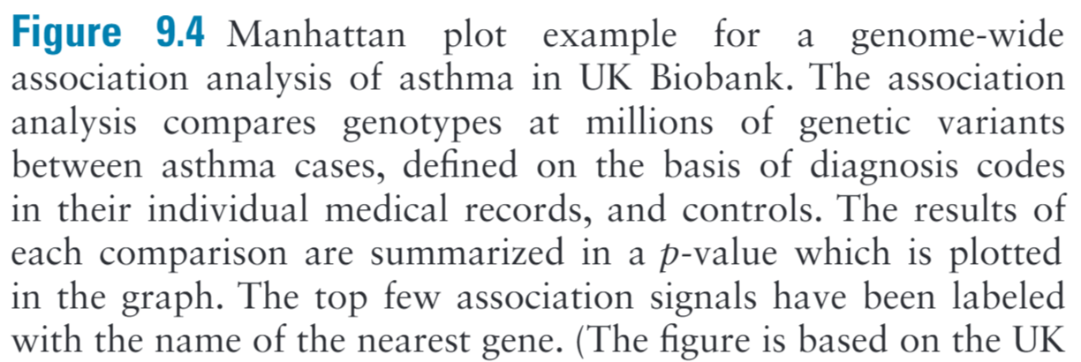

Slide 13
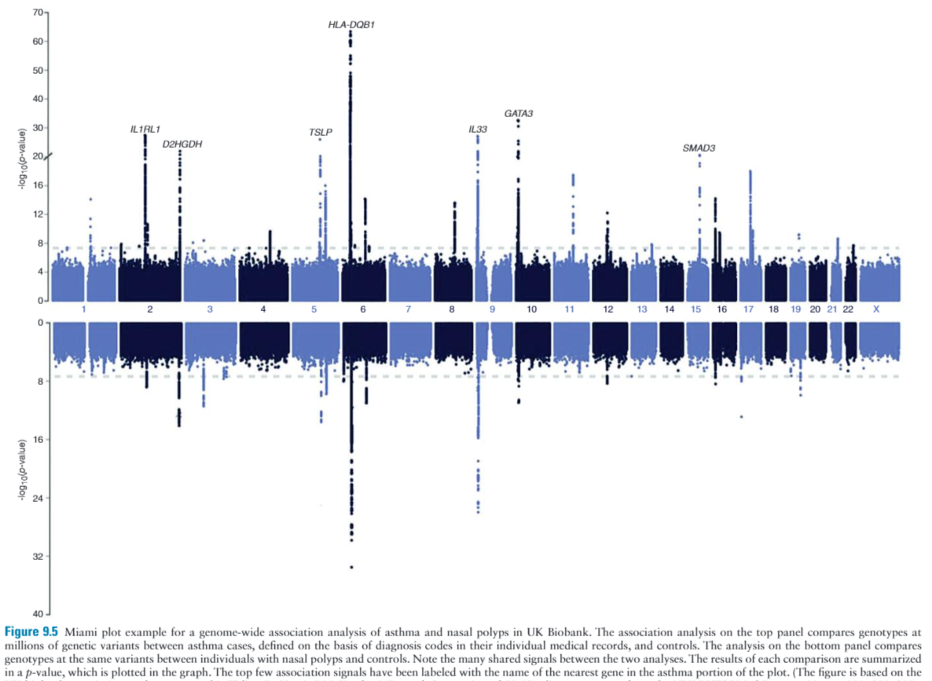

Slide 14
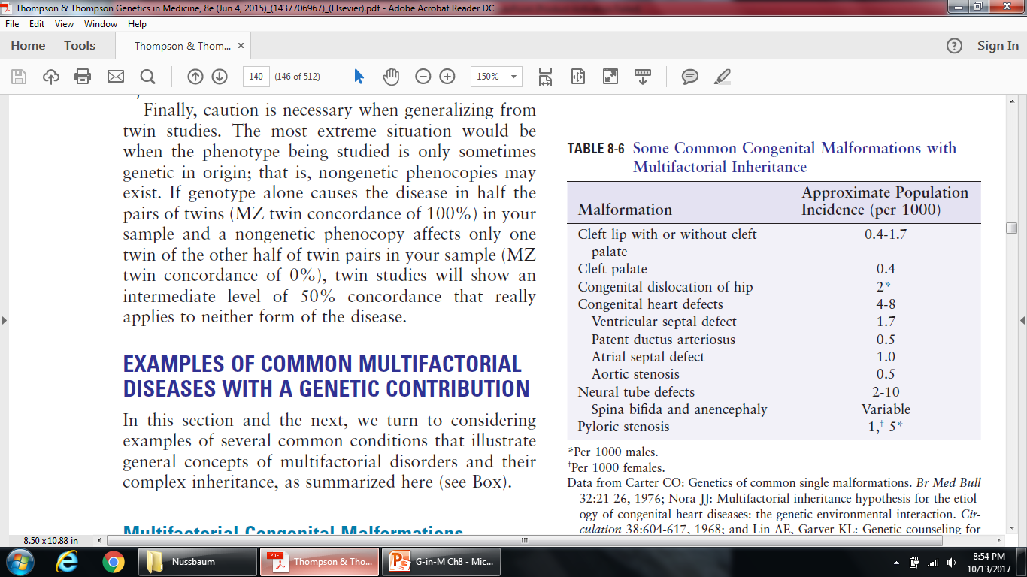
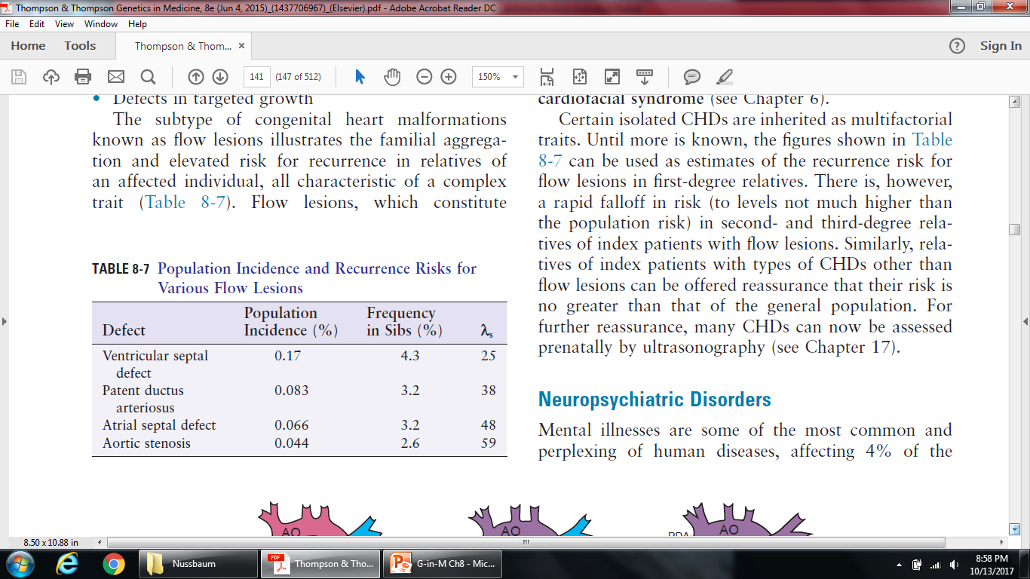
TABLE 9-6
EXAMPLES OF COMMON MULTIFACTORIAL DISEASES WITH A GENETIC CONTRIBUTION
TABLE 9-7

Slide 15
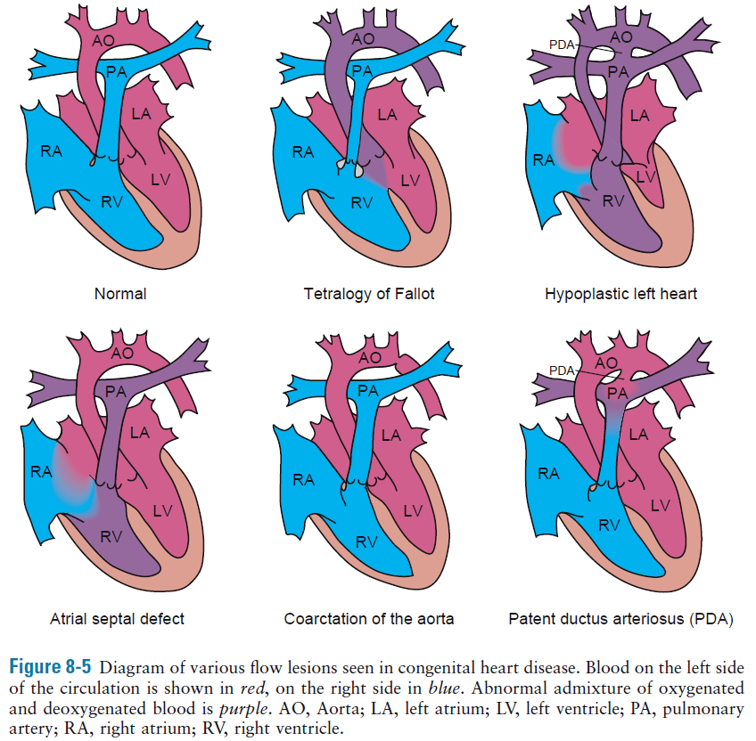
Figure 9-7

Slide 16
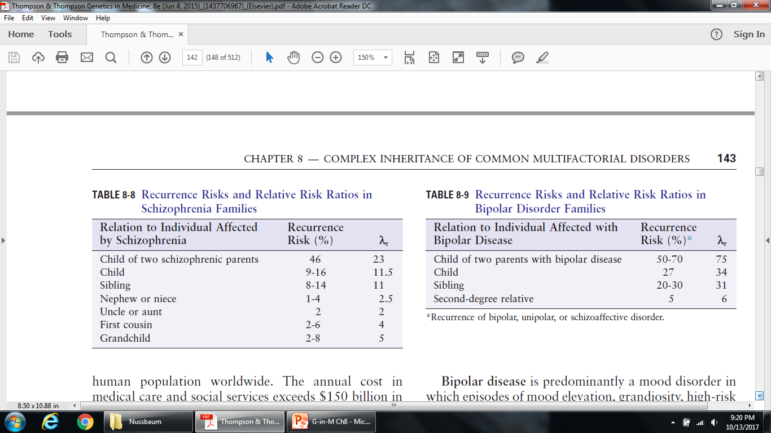
TABLE 9-8
MZ: 40-60%
DZ: 10-16%
25% of 22q11 deletions develop schizophrenia
MZ: 40-60%
DZ: 4-8%
Less is known about genes predisposing
TABLE 9-9

Slide 17
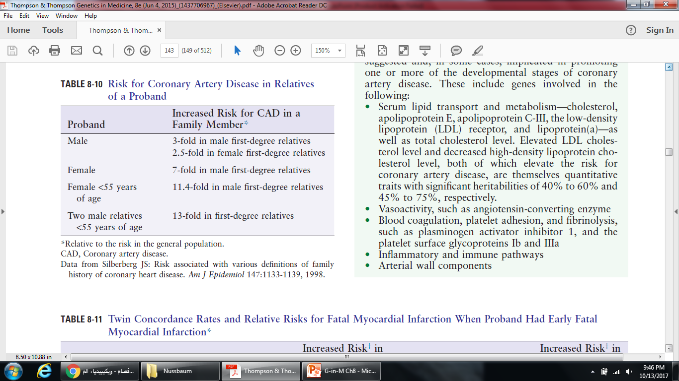
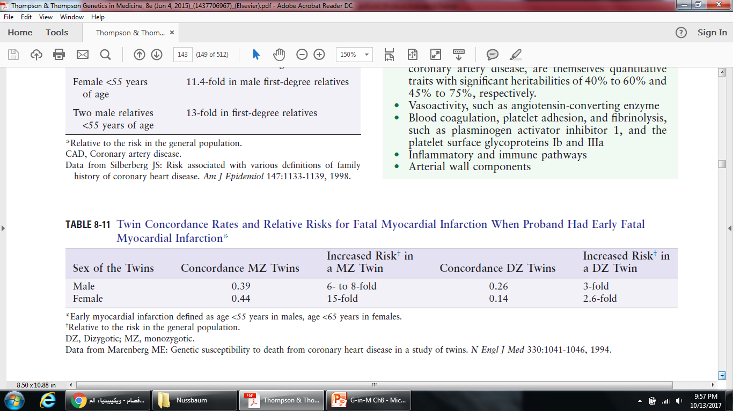
TABLE 9-10
TABLE 9-11

Slide 18
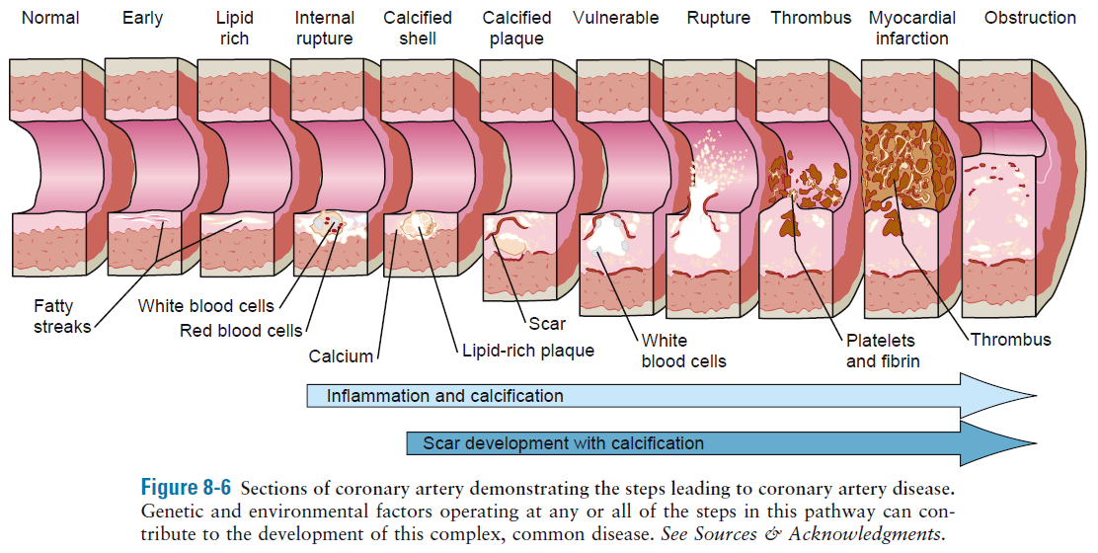
Figure 9-8

Slide 19
EXAMPLES OF MULTIFACTORIAL TRAITS FOR WHICH SPECIFIC GENETIC AND ENVIRONMENTAL FACTORS ARE KNOWN
Modifier Genes in Mendelian Disorders
Cystic fibrosis, CFTR gene
degree of pulmonary disease is affected by genetic modifiers
MBL2, mannose-binding lectin
TGFB1, transforming growth factor β
modifier genes that do not cause CF but modify the clinical phenotype

Slide 20
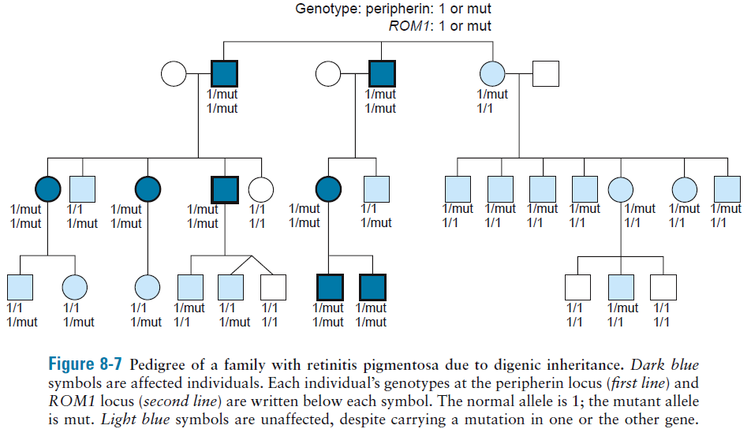
Digenic Inheritance
Figure 9-9

Slide 21
Gene-Environment Interactions in Venous Thrombosis
Idiopathic cerebral vein thrombosis
Three factors lead to abnormal coagulability of clotting system:
A missense mutation in the gene for clotting factor V, Leiden R506Q, seven-fold increase in risk
A variant in 3’ UTR of the gene for clotting factor prothrombin, g.20210G>A, three to six-fold increase in risk
Oral contraceptives, fourteen to twenty-two-fold increase in risk
Deep venous thrombosis (DVT)

Slide 22
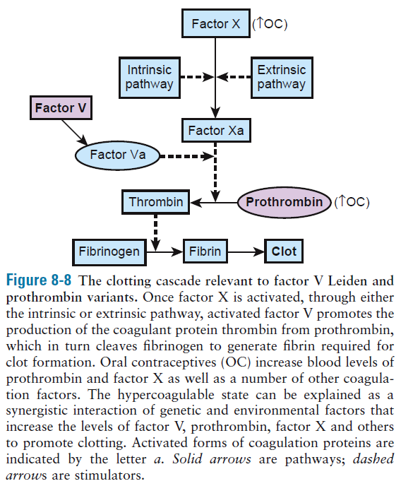
Figure 9-10

Slide 23
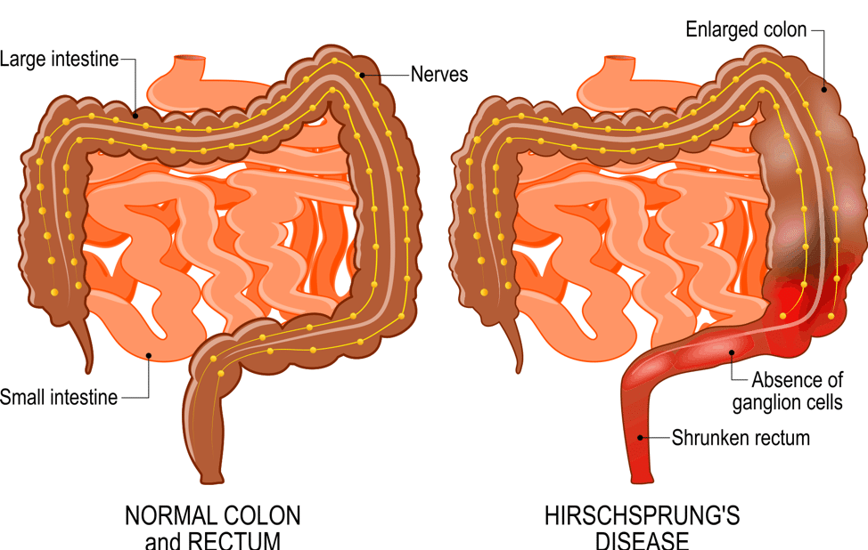
Multiple coding and noncoding elements in Hirschsprung disease
Complete absence of some or all of the ganglion cells in colon
An aganglionic colon is incapable of peristalsis, resulting in severe constipation, symptoms of intestinal obstruction, and massive dilation of the colon (megacolon).

Slide 24
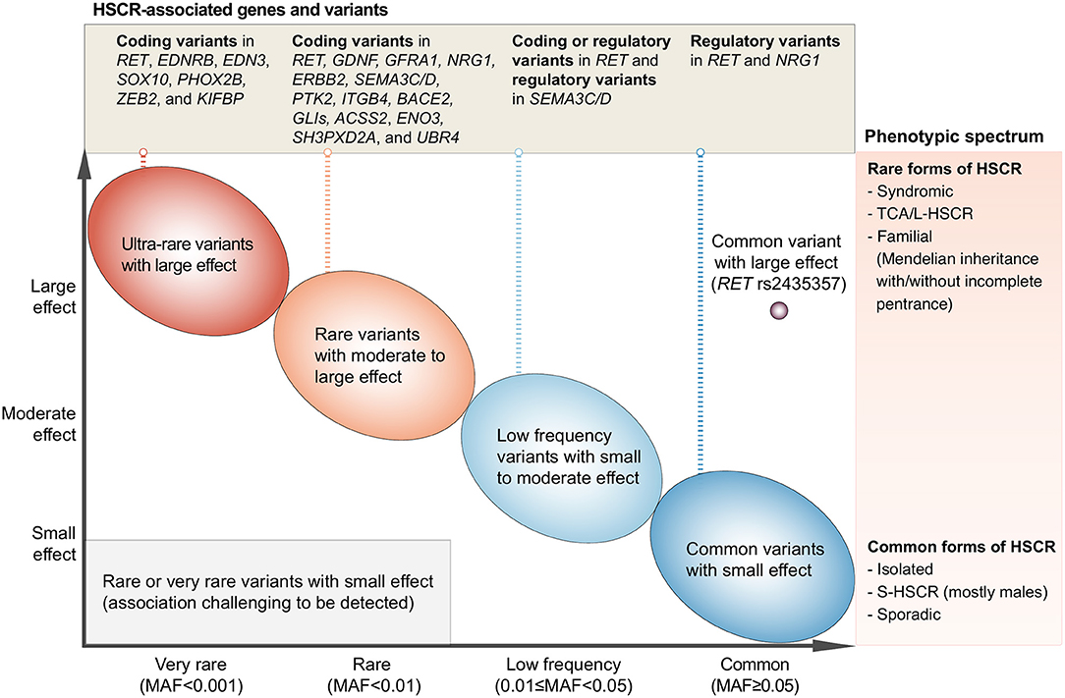
Multiple Coding and Noncoding Elements in Hirschsprung Disease
Figure 9-11 Current understanding of the genetic factors underlying inheritance of HSCR. As with most complex traits, genetic susceptibility can be explained by common variants with relatively small impacts on individual risk, and a spectrum toward very rare alleles with substantial impact on risk. HSCR shows phenotypic severity differences – syndromic HSCR and TCA/L-HSCR are more rare and severe, whereas sporadic S-HSCR is more common.

Slide 25
Type 1 Diabetes Mellitus
T1D 10%
T2D 88%
Incidence of T1D is 0.2%
Concordance in MZ is 40%
Risk in sibling of an affected is 7%
λ_{s} = 35
The major genetic factor in T1D is the major histocompatibility complex (MHC) locus
MHC is the most polymorphic locus, >200 genes, >2000 alleles
Human leukocyte antigen HLA class I (HLA-A, HLA-B, HLA-C)
HLA class II (HLA-DP, HLA-DQ, HLA-DR)

Slide 26
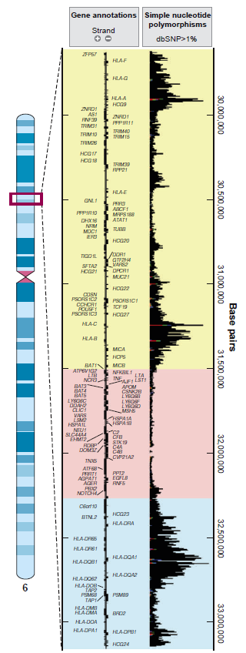
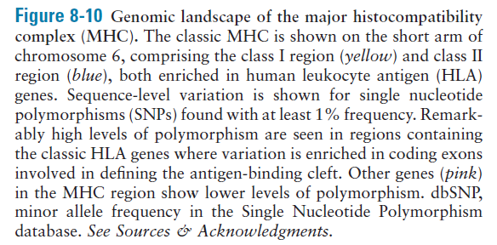
Figure 9-12

Slide 27
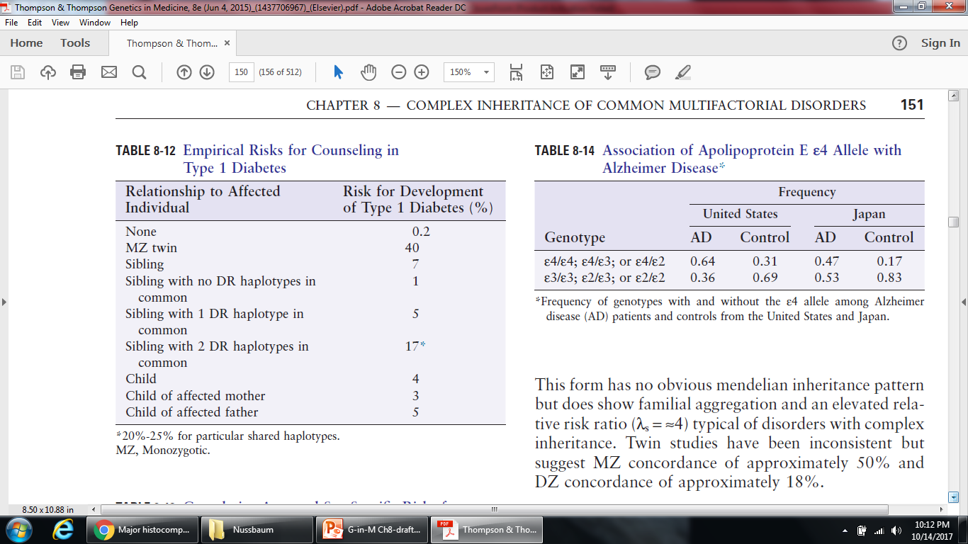
TABLE 9-12
Still less than 40%, thus, other genes are involved

Slide 28
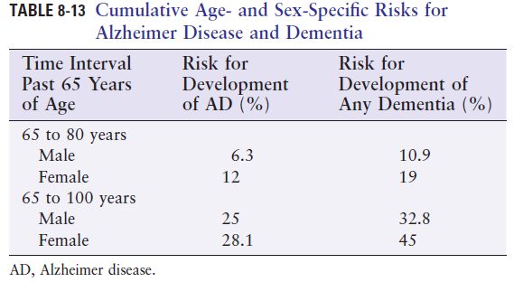
Alzheimer Disease
Affects 1-2% of the population, most common cause of dementia in older adults
Risk factors: age, sex, and family history
Can be diagnosed definitively only postmortem
TABLE 9-13

Slide 29
Apolipoprotein E is involved in clearing LDL through interaction with high-affinity receptors in the liver
Patients with two ε4 alleles have an earlier age at onset
TABLE 9-14

Slide 30
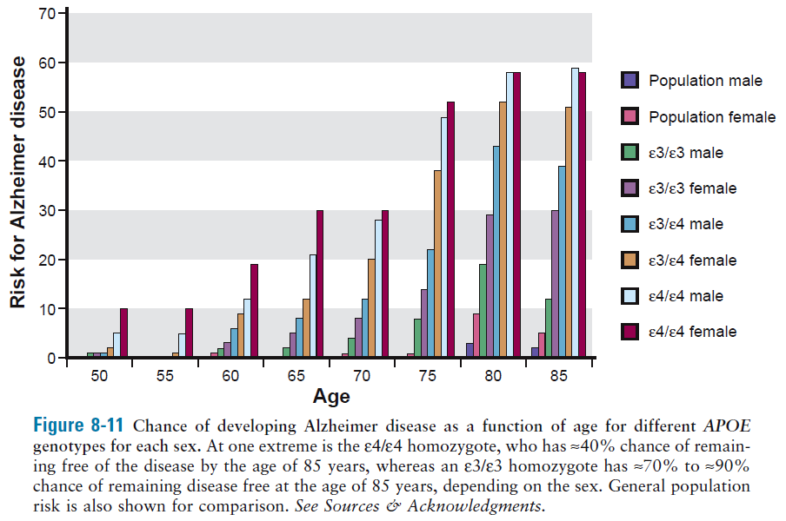
Figure 9-13

Slide 31
The ε4 variant of APOE represents a prime example of a predisposing allele:
it predisposes to a complex trait in a powerful way but does not predestine any individual carrying the allele to the disease.

